Slide 1

Capstone Project:
A novel, real-time step counting algorithm
Henry Valk

Slide 2
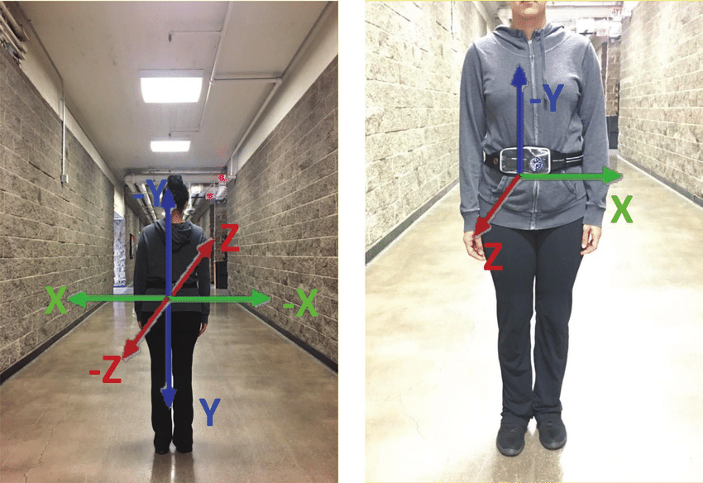
Step Counting: Current Methods
Accelerometer: measures linear acceleration (m/sec2)
Gyroscope: measures angular velocity (degrees/sec)
Common Methods
Windowed peak detection
Pros: computationally inexpensive
Cons: susceptible to false positives
Academic Research
Template Based (DTW, Wavelet)
Frequency Based (autocorrelation, FFT)
Feature-Based Neural Networks
Pros: highly accurate
Cons: computationally expensive, can require massive amount of training data

Slide 3
Proposed Algorithm
Accelerometer Z
0.5 sec interval
no
Goals
Better accuracy than peak detection
Considers computational efficiency
Remains white-box / intuitive / parameter-light
yes
Frequency-Based Walk Detection
Walking
no
yes
Template-Based
Step Counter
Increment step count
Step
yes

Slide 4

Brajdic & Harle 2013 Walking Dataset
Smartphone accelerometer data from 27 participants (23 used here)
Data gathered with smartphone in 6 positions (“handheld / not-in-use” used as a proxy for a wrist-worn device)
Total steps and walking onset / offset timestamps recorded, however individual step timestamps unknown

Slide 5
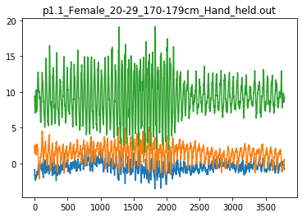
UbiComp Sample Data
Linear Acceleration (m/sec2)
Samples

Slide 6
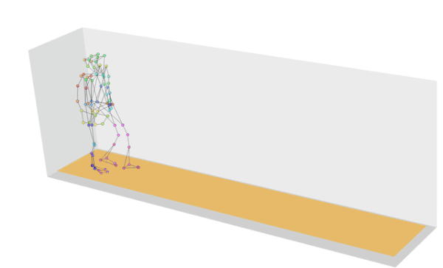
Frequency-Based Walk Detection
Most people walk with a stride rate between 1.2 and 2.4 hz
By transforming the accelerometer signal from the time domain to the frequency domain, we can assess whether the incoming signal shows a stride rate consistent with walking

Slide 7
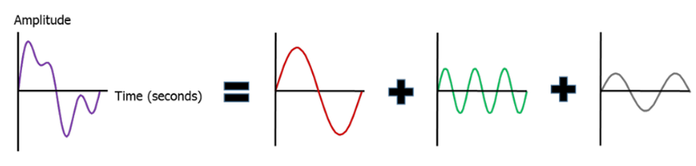
Fourier Transform

Slide 8
Fourier Transform
2 hz
6 hz
3 hz

Slide 9
Fourier Transform
2 hz
6 hz
3 hz
FFT
2 hz
3 hz
6 hz

Slide 10
Frequency-Based Walk Detection
If sample_count >= 250 and sample_count % 50 == 0:
if FT(last250samples, 1.2 : 2.4) > FT(last250samples,0 : 1.2) and FT(last250samples, 1.2 : 2.4) > threshold:
walking = True
else:
walking = False
Binned Power Spectrum Density
Kang, X., Huang, B., & Qi, G. (2018). A Novel Walking Detection and Step Counting Algorithm Using Unconstrained Smartphones. Sensors (Basel, Switzerland), 18(1), 297. https://doi.org/10.3390/s18010297
1.2 hz
2.4 hz

Slide 11
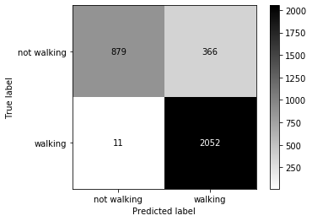
Offline Walk Detection Performance
Specificity | 0.7235
Sensitivity | 0.9946

Slide 12
Accelerometer Z
0.5 sec interval
no
yes
Frequency-Based Walk Detection
Walking
no
yes
Template-Based
Step Counter
Increment step count
Step
yes

Slide 13
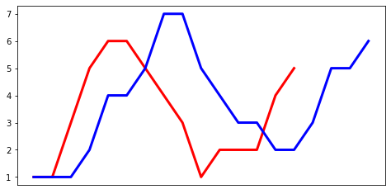
Template-Based Step Counter
Comparing incoming data to an ideal step or average step template
A = [1,1,3,5,6,6,5,4,3,1,2,2,2,4,5]
B = [1,1,1,2,4,4,5,7,7,5,4,3,3,2,2,3,5,5,6]

Slide 14
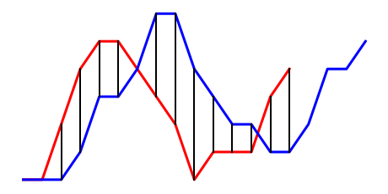
Template-Based Step Counter
Comparing incoming data to an ideal step or average step template
A = [1,1,3,5,6,6,5,4,3,1,2,2,2,4,5]
B = [1,1,1,2,4,4,5,7,7,5,4,3,3,2,2,3,5,5,6]

Slide 15
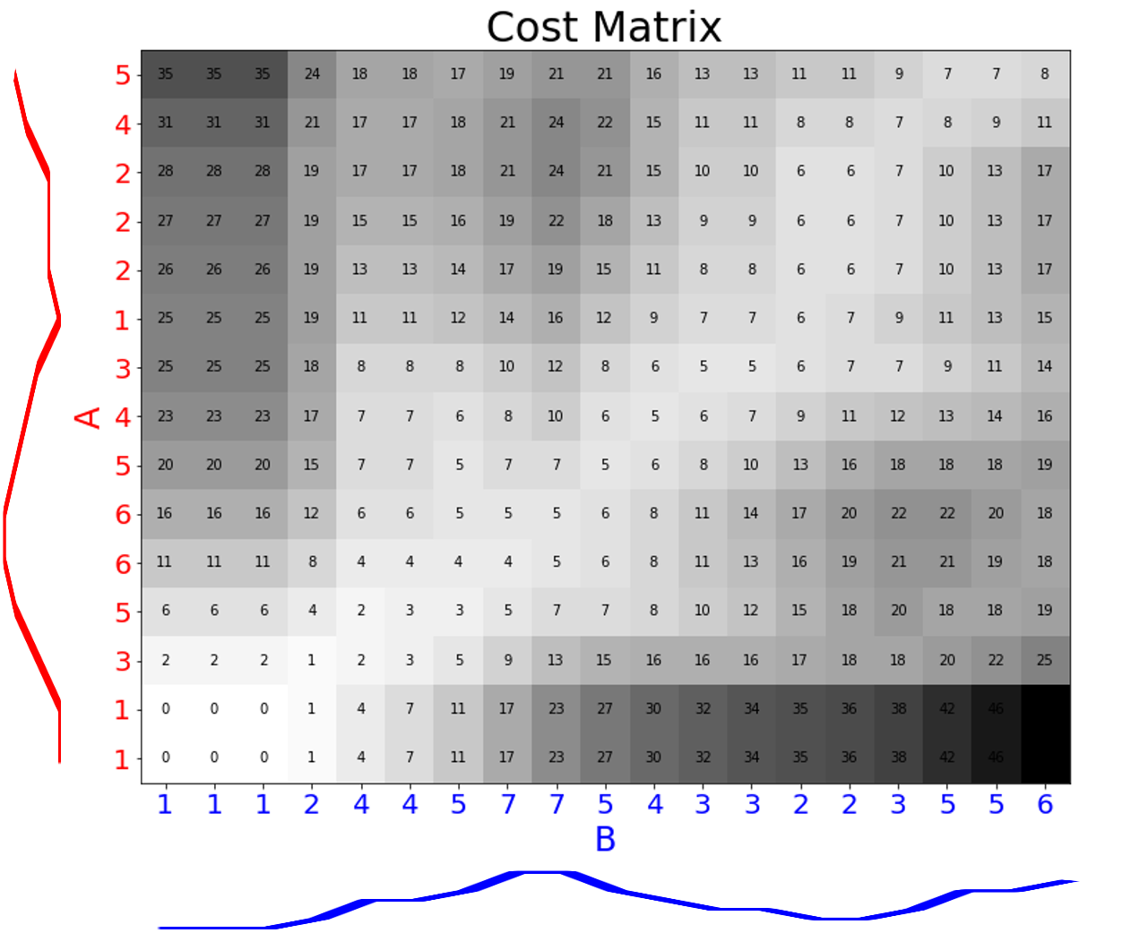
Dynamic Time Warping

Slide 16
Dynamic Time Warping
DTW(i,j) = d(Ai ,Bj ) + min{ DTW(i-1,j-1), …………………………......…DTW(i-1,j ), ……………………....…..……DTW(i,j-1)}
A
B

Slide 17
Dynamic Time Warping
DTW(i,j) = d(Ai ,Bj ) + min{ DTW(i-1,j-1), …………………………......…DTW(i-1,j ), ……………………....…..……DTW(i,j-1)}
A
B

Slide 18
Dynamic Time Warping
DTW(i,j) = d(Ai ,Bj ) + min{ DTW(i-1,j-1), …………………………......…DTW(i-1,j ), ……………………....…..……DTW(i,j-1)}
DTW(i,j) = abs(3-4) + min{ 4, ………………………….....…7, ……………………..,......……2}
DTW(i,j) = 1 + 2 = 3
A
B

Slide 19

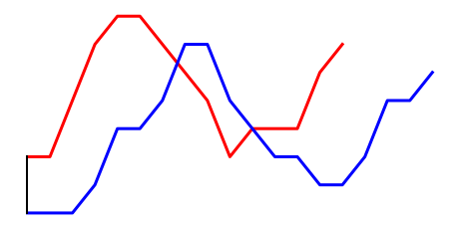
Dynamic Time Warping

Slide 20
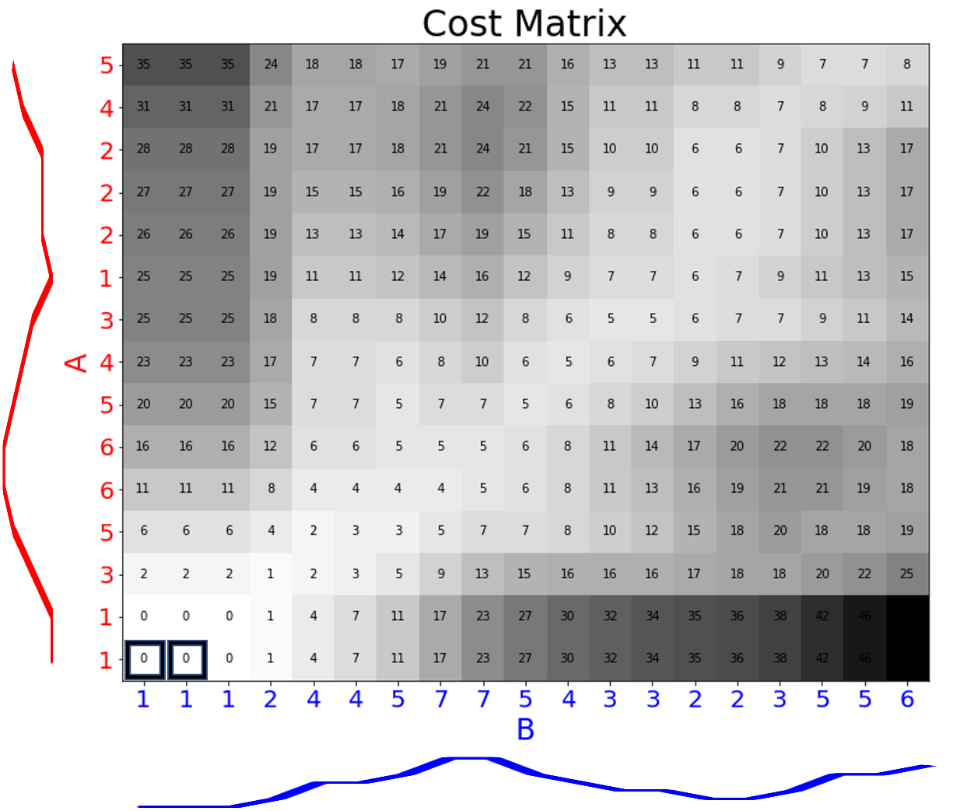
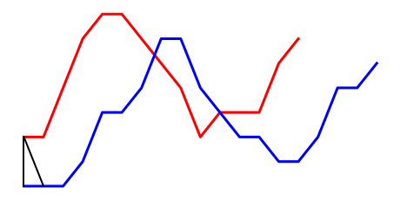
Dynamic Time Warping

Slide 21

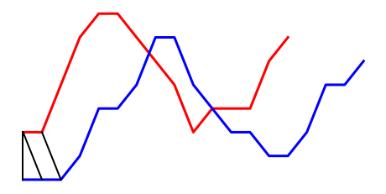
Dynamic Time Warping

Slide 22
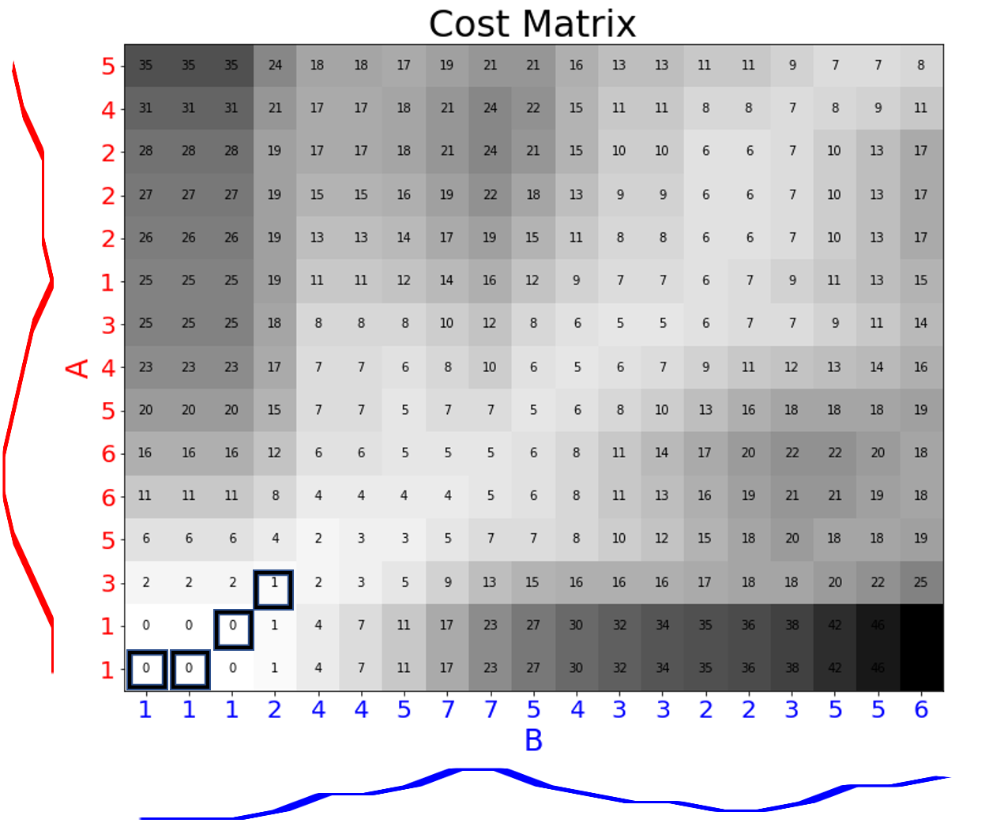
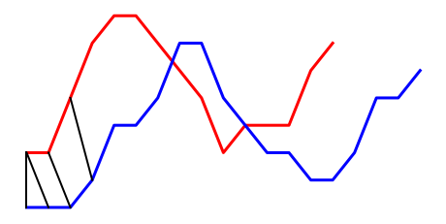
Dynamic Time Warping

Slide 23
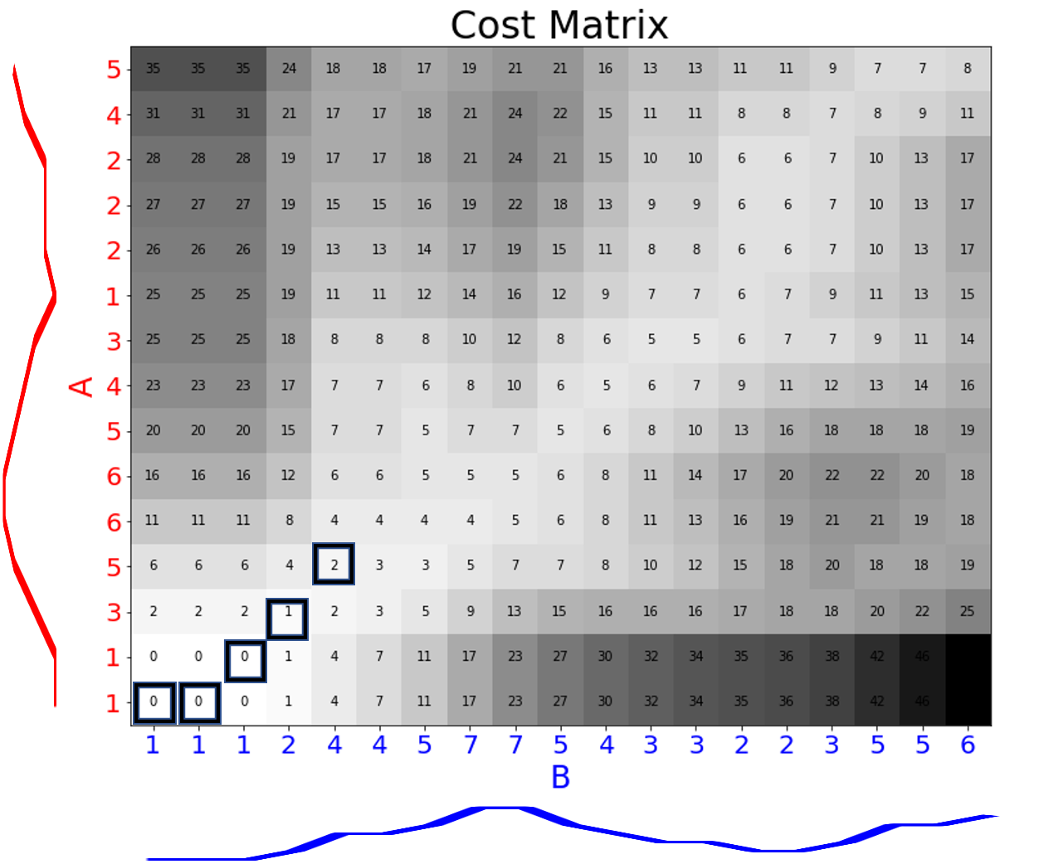
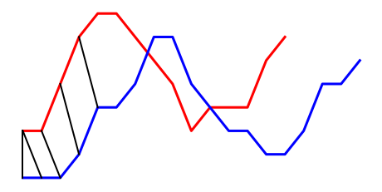
Dynamic Time Warping

Slide 24
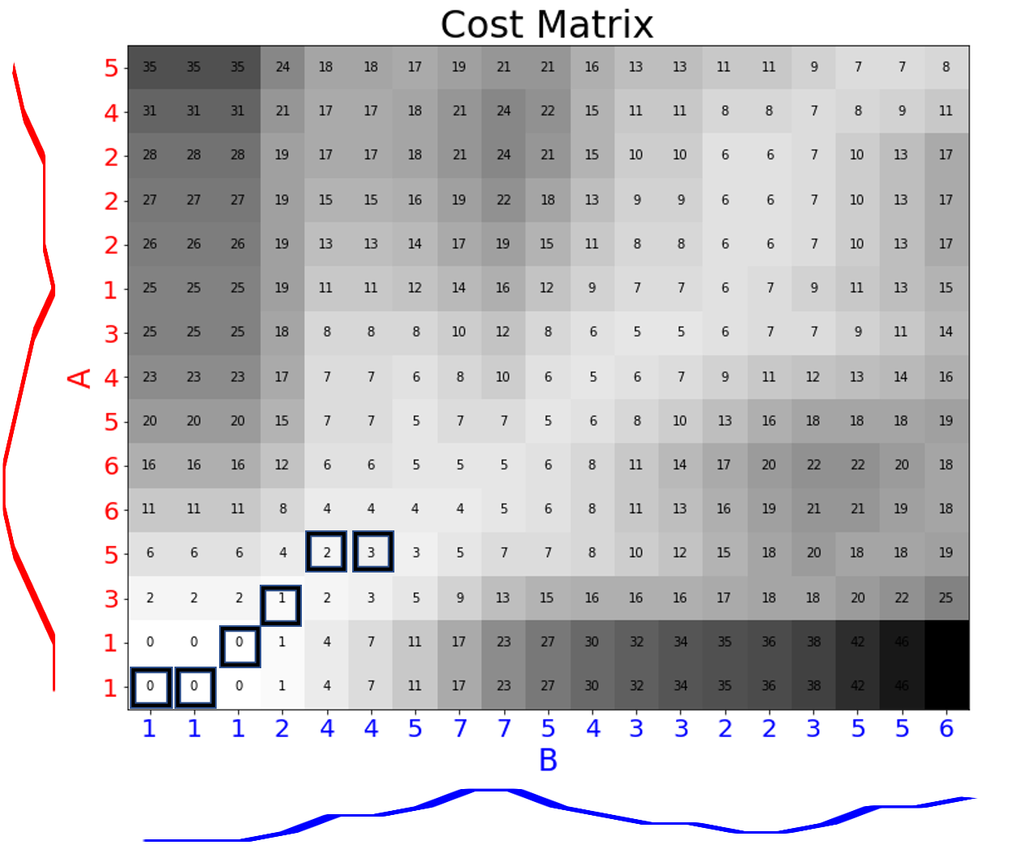
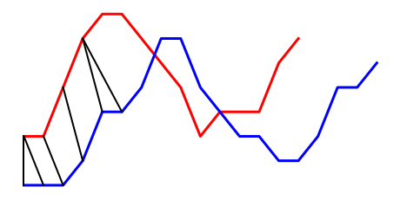
Dynamic Time Warping

Slide 25
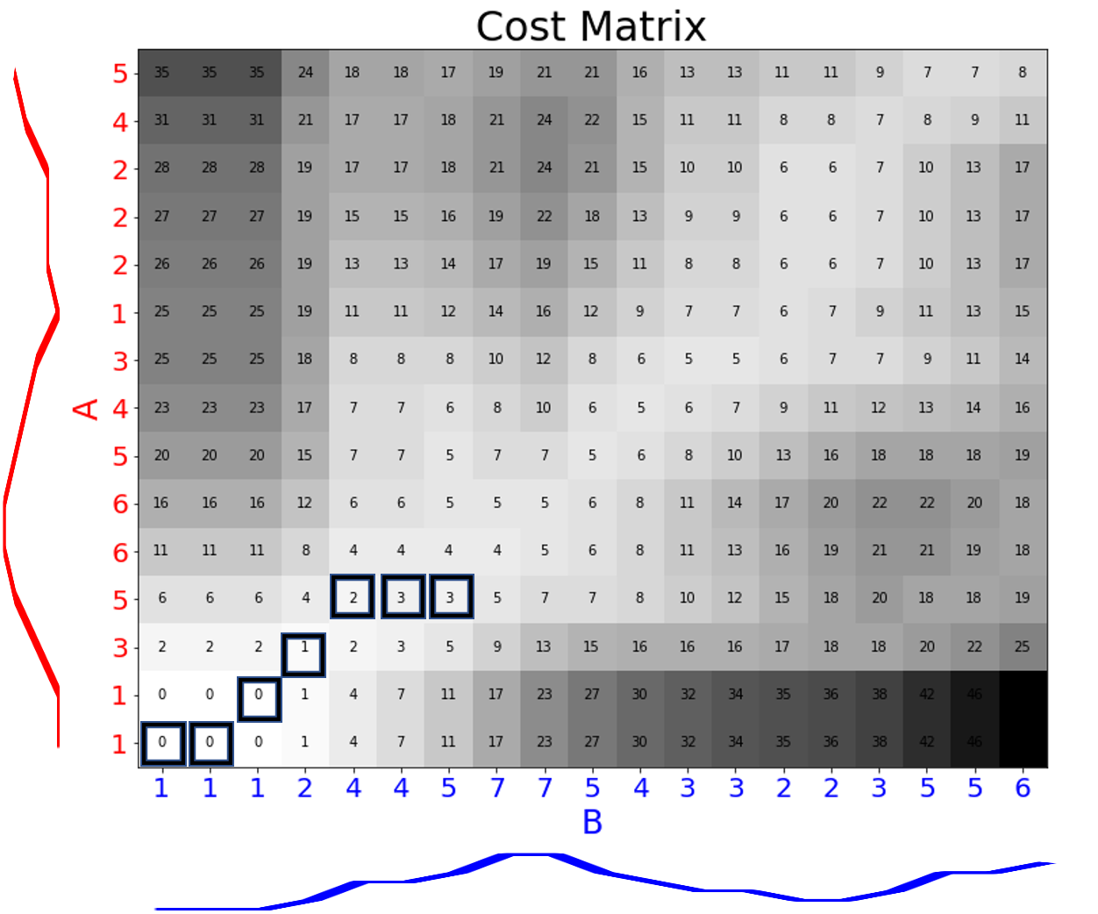
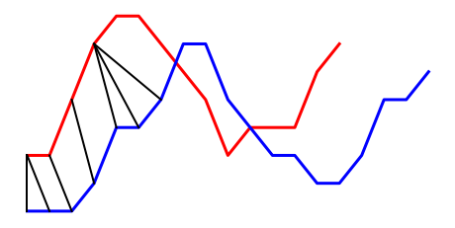
Dynamic Time Warping

Slide 26
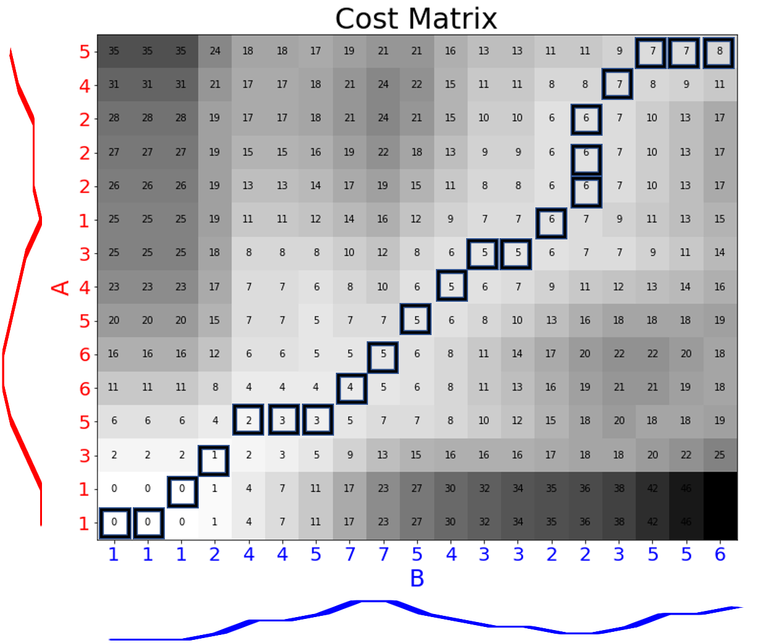
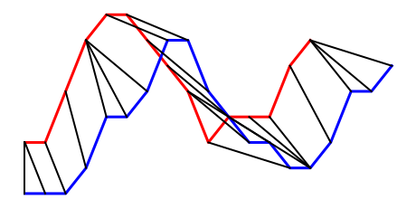
Dynamic Time Warping

Slide 27
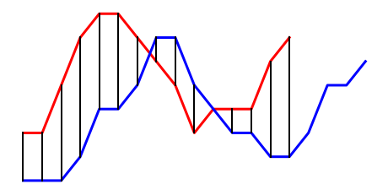
Dynamic Time Warping

Slide 28
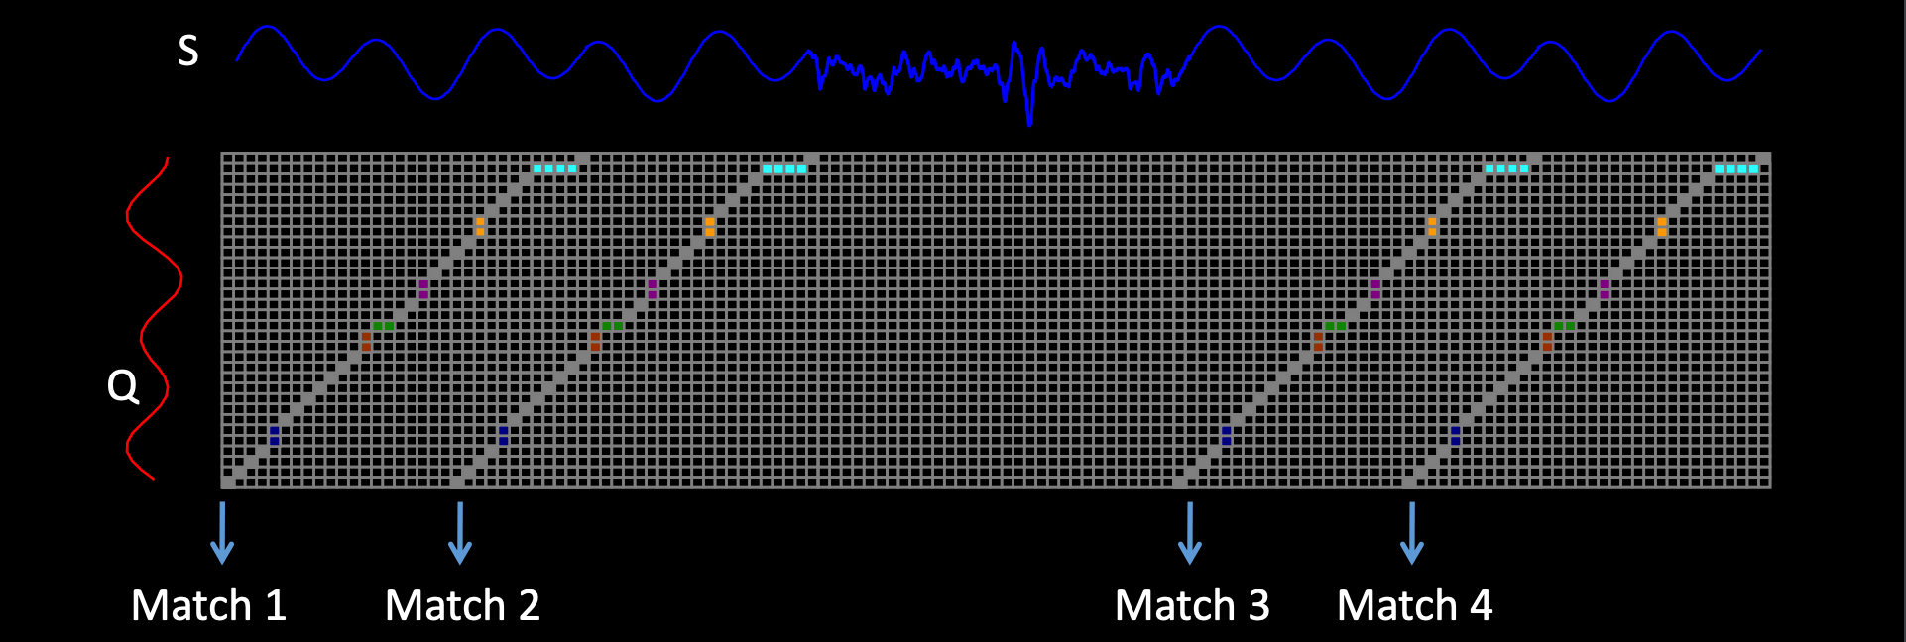
DTW SPRING
Yasushi Sakurai, Christos Faloutsos, Masashi Yamamuro: Stream Monitoring under the Time Warping Distance. ICDE 2007:1046-1055
Image: Abdullah Mueen, Eamonn J. Keogh: Extracting Optimal Performance from Dynamic Time Warping. KDD 2016: 2129-2130

Slide 29
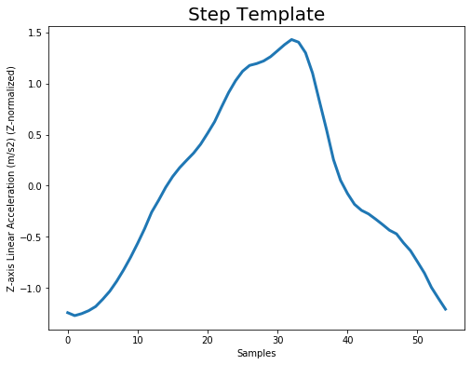
Step Template
Mean step from 23 participants in UbiComp dataset
Approximately 1.8hz stride rate

Slide 30
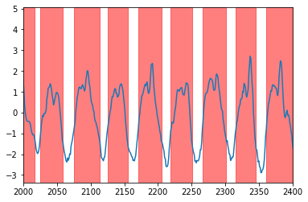
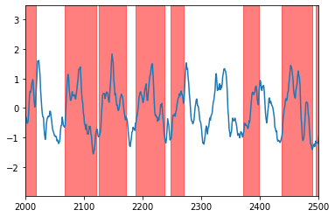
Sample Step Counting
DTW SPRING with step template and UbiComp walking data

Slide 31
Offline Step Count Accuracy
True Step Count | Steps Counted | % Error
74 | 64 | 0.13513514
85 | 79 | 0.07058824
... | ... | ...
85 | 70 | 0.17647059
70 | 64 | 0.08571429
Overall Accuracy: 87.16%

Slide 32
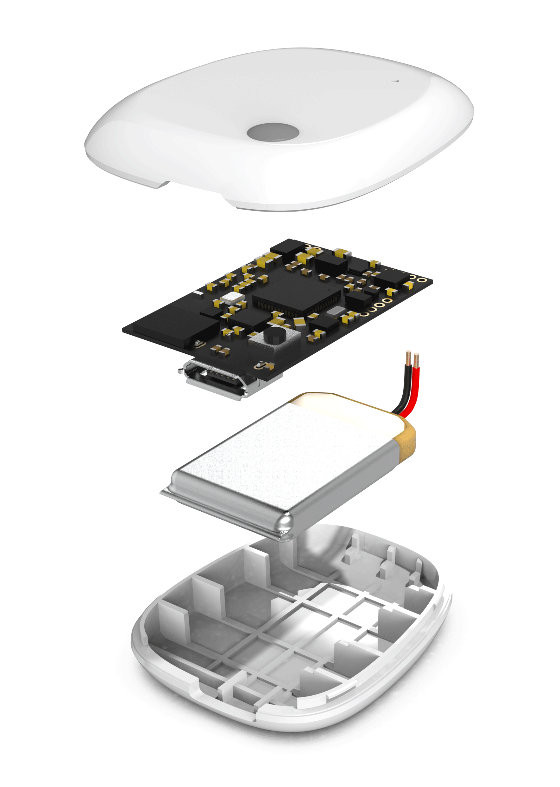
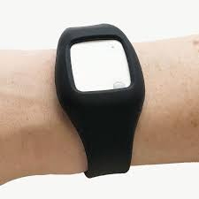
MbientLab MetaMotionR
100hz sampling rate
Accelerometer, gyro, magnetometer, temperature, barometer
Stream via Bluetooth LE

Slide 33

MetaWear API
Python3 API that wraps around the MetaWear C++ library
Supported on Linux
All development done in VirtualBox virtual machine running latest Ubuntu

Slide 35
Limitations and Future Directions
Write code in Swift and run from a mobile app
Save output to CSV file
Measure ground truth step count for more accurate algorithm evaluation
Replicate algorithm for running, walking down stairs, etc
Fine tuning:
Compare accuracy at different sampling rates
Try multidimensional DTW SPRING

Slide 36
Thank you!
Yasushi Sakurai, Christos Faloutsos, Masashi Yamamuro: Stream Monitoring under the Time Warping Distance. ICDE 2007:1046-1055
Abdullah Mueen, Eamonn J. Keogh: Extracting Optimal Performance from Dynamic Time Warping. KDD 2016: 2129-2130
Kang, X., Huang, B., & Qi, G. (2018). A Novel Walking Detection and Step Counting Algorithm Using Unconstrained Smartphones. Sensors (Basel, Switzerland), 18(1), 297. https://doi.org/10.3390/s18010297
Harle, R., & Brajdic, A. (2017). Research data supporting "Walk detection and step counting on unconstrained smartphones" [Dataset]. https://doi.org/10.17863/CAM.12982
Shokoohi-Yekta, M., Hu, B., Jin, H., Wang, J., & Keogh, E. (2017). Generalizing DTW to the multi-dimensional case requires an adaptive approach. Data mining and knowledge discovery, 31(1), 1–31. https://doi.org/10.1007/s10618-016-0455-0
Nikolas Rieble - https://stackoverflow.com/questions/36549932/pattern-detection-in-time-series-data
http://scipy.github.io/devdocs/generated/scipy.signal.welch.html
https://mbientlab.com/tutorials/CppDevelopment.html

